Slide 1
Simulation and Optimization in School Choice
Dr. Peng Shi, Department of Data Sciences and Operations,
USC Marshall School of Business

Slide 2
Takeaways
Simulations help bypass rhetorical gridlock.
LP/MIP modeling is powerful.
Optimization + simulation: powerful and persuasive prescriptive analytics.

Slide 3
Outline
Problem
Background
Policy question
Simulation
Modeling preferences
Outcomes
Valid
ation
Optimization
Formulation
Approximation using assortment planning
Computing socially-optimal assortments

Slide 4
Background on School Choice
Student Characteristics
Home Location
Menus
Priorities
Choice Ranking
Assignment Algorithm
School Assignment
Implemented in Boston, Cambridge, Chicago, Denver, Miami, New Orleans, NYC, San Francisco, Washington DC …

Slide 5
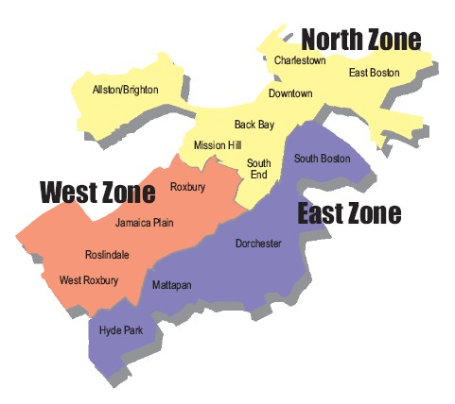
Assignment Plan in Boston in 2012
Menus: Any school in zone or walk-zone.
Priorities:
Walk-zone (applies in 50% of seats)
Random number for each student
Main entry grade K2:
75 schools
123 programs
≈20-60 seats/program

Slide 6

Assignment Algorithm in Boston
Student-Proposing Deferred Acceptance (DA): [Gale & Shapley 1962], [Abdulkadiroğlu & Sönmez 2003]
Student applies to top choice.
School tentatively accepts.
If capacity is violated, bump out least priority student.
Bumped student applies to next choice; iterate.
 | Bob | Alice
Menus | A, B, … | A, B, …
Walk-zone |  | A
Random number | 0.9 | 0.2
Preferences | A, B, … | A, B, …
School A
School B
Bob applies to top choice (A), tentatively accepted.

Slide 7

Assignment Algorithm in Boston
Student-Proposing Deferred Acceptance (DA): [Gale & Shapley 1962], [Abdulkadiroğlu & Sönmez 2003]
Student applies to top choice.
School tentatively accepts.
If capacity is violated, bump out least priority student.
Bumped student applies to next choice; iterate.
 | Bob | Alice
Menus | A, B, … | A, B, …
Walk-zone |  | A
Random number | 0.9 | 0.2
Preferences | A, B, … | A, B, …
School A
School B
Alice applies to top choice (A), capacity of A exceeded!

Slide 8
Assignment Algorithm in Boston
Student-Proposing Deferred Acceptance (DA): [Gale & Shapley 1962], [Abdulkadiroğlu & Sönmez 2003]
Student applies to top choice.
School tentatively accepts.
If capacity is violated, bump out least priority student.
Bumped student applies to next choice; iterate.
 | Bob | Alice
Menus | A, B, … | A, B, …
Walk-zone |  | A
Random number | 0.9 | 0.2
Preferences | A, B, … | A, B, …
School A
School B
Bob is bumped out.

Slide 9
Assignment Algorithm in Boston
Student-Proposing Deferred Acceptance (DA): [Gale & Shapley 1962], [Abdulkadiroğlu & Sönmez 2003]
Student applies to top choice.
School tentatively accepts.
If capacity is violated, bump out least priority student.
Bumped student applies to next choice; iterate.
 | Bob | Alice
Menus | A, B, … | A, B, …
Walk-zone |  | A
Random number | 0.9 | 0.2
Preferences | A, B, … | A, B, …
School A
School B
Bob applies to next choice (B), tentatively accepted.

Slide 10
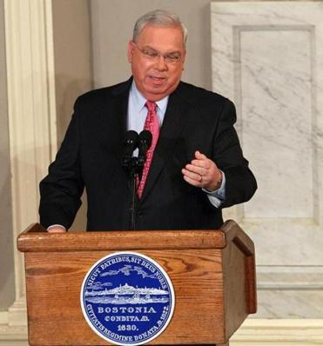
2012-2013 school assignment reform
“But something stands in the way of taking our system to the next level: a student assignment process that ships our kids to schools across our city….
I’m committing tonight that one year from now Boston will have adopted a radically different student assignment plan – one that puts a priority on children attending schools closer to their homes.”
- Former Mayor Menino, 2012 State of the City Address

Slide 11
Pros and Cons of Boston’s System in 2012
Pros
Choices help find better match.
Easier capacity planning.
More equitable than assigning to closest school.
Incentive-compatibility. [Dubins & Freedman 1981], [Roth 1982]
Cons
High transportation cost for the city.
Community dispersion.
Unpredictability.
Menu not centered around student.
Inequities across zones.

Slide 12
Question: What Menus and Priorities to Use?
Home Location
Menus
Priorities
Optimizing menus and priorities to induce better assignment:
Choice Ranking
DA Algorithm
Busing savings
Students’ “happiness”
Predictability
Community cohesion
School Assignment

Slide 13
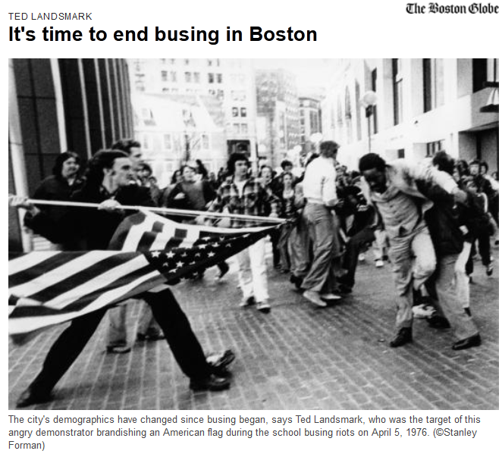
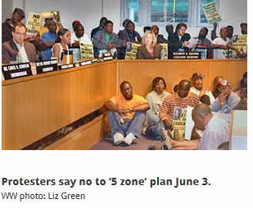
Politically Charged Issue
Riot in 1976
Failed Reform in 2009

Slide 14
A Simple Proposal: The Home-Based Plan
Menus: union of
Any school in walk-zone.
Closest 2 Tier 1 schools.
Closest 4 Tier 1 or 2 schools.
Closest 6 Tier 1, 2 or 3 schools.
Closest 3 “big” schools.
Intuition:
Decrease busing burden.
Centered menus.
Compensate “worse” neighborhoods with more choices.
Intuitively appealing, but how will it perform?

Slide 15
Outline
Problem
Background
Policy question
Simulation
Predictive modeling
Defining metrics
Simulating outcomes
Optimization

Slide 16
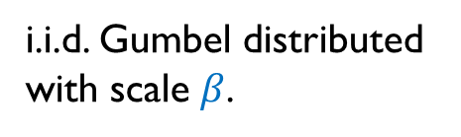
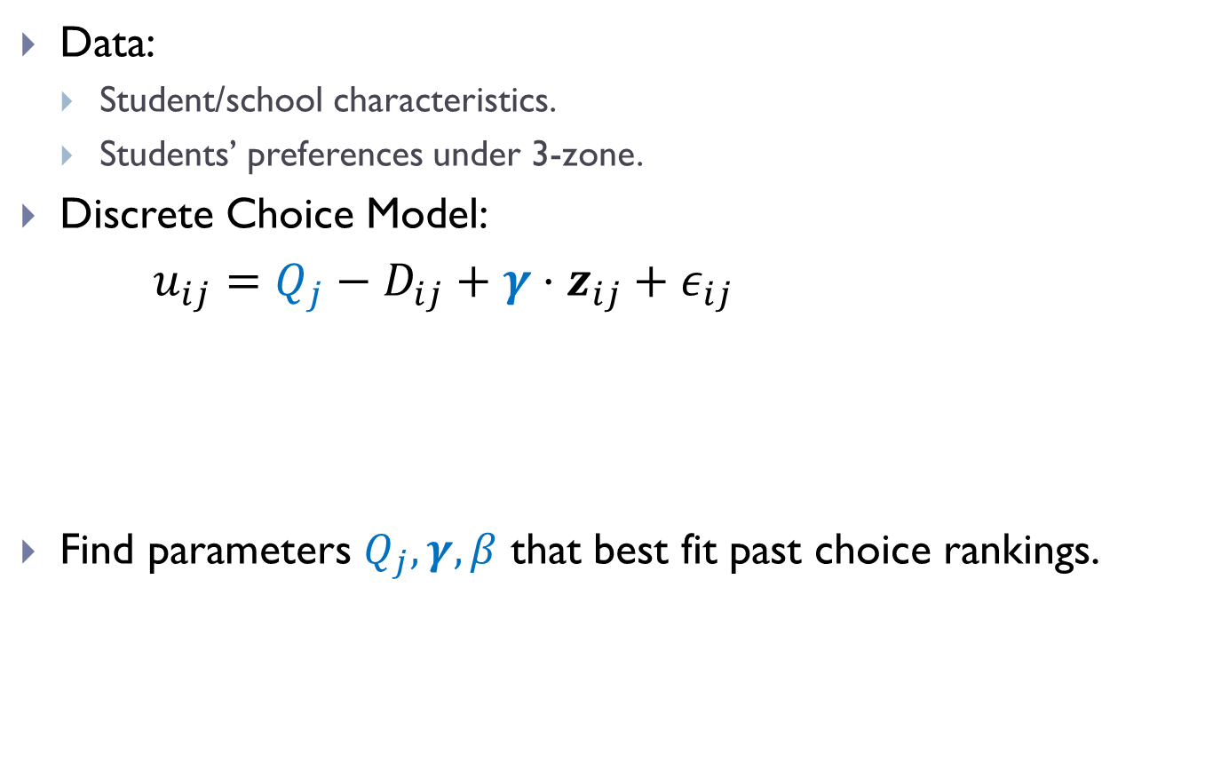
Predictive Modeling
Data:
Student/school characteristics.
Students’ preferences under 3-zone.
Discrete Choice Model:
$u_{ij}=Q_{j}−D_{ij}+γ⋅z_{ij}+ε_{ij}$
Find parameters $Q_{j}, γ,β$ that best fit past choice rankings.
distance
student-school characteristics
utility
i.i.d. Gumbel distributed with scale$β$.
“quality”

Slide 17
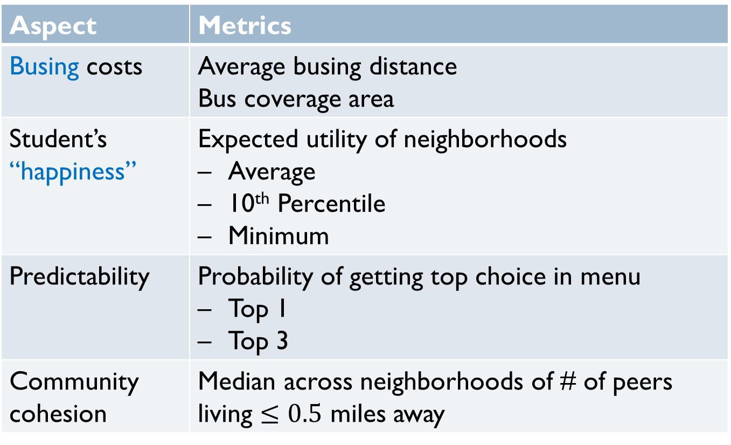
Defining Metrics
Aspect | Metrics
Busing costs | Average busing distance Bus coverage area
Student’s “happiness” | Expected utility of neighborhoods Average 10th Percentile Minimum
Predictability | Probability of getting top choice in menu Top 1 Top 3
Community cohesion | Median across neighborhoods of # of peers living $≤0.5$ miles away

Slide 18
Simulating Outcomes
Simulating future students.
Home Location
Generate Scenario
Menus
Priorities
Simulating choices under new menus.
Choice Ranking
DA Algorithm
Simulate Scenario
Simulating assignment outcomes:
School Assignment

Slide 19
Simulation Results
Metric | 3-Zone | Home-Based
Average # of choices: | 27.5 | 14.8
Average busing (miles) | 1.3 | 0.6
Bus coverage (sq. miles) | 20.9 | 8.5
Expected utility (miles)
Average | 7.4 | 7.0
10th percentile | 6.6 | 6.1
Minimum | 5.1 | 4.5
Prob. of getting top choice in menu
Top 1 | 63% | 64%
Top 3 | 84% | 85%
# of peers living within half mile (median) | 3.1 | 5.0
Busing is more than halved
Student’s utilities
decrease slightly.
Improved cohesion

Slide 20
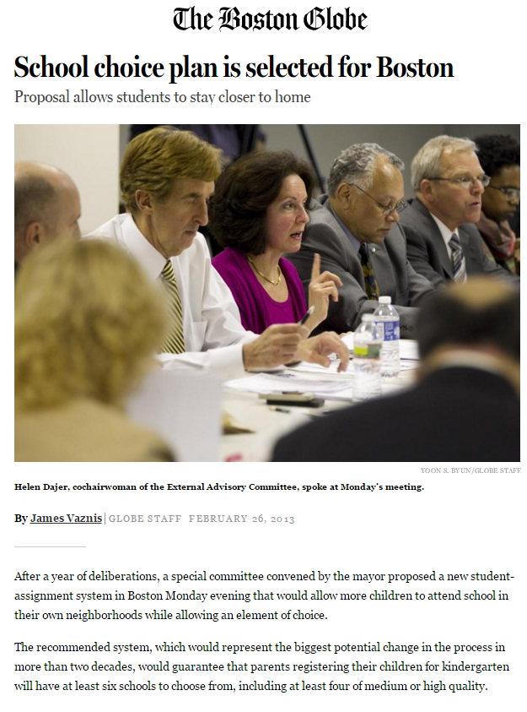
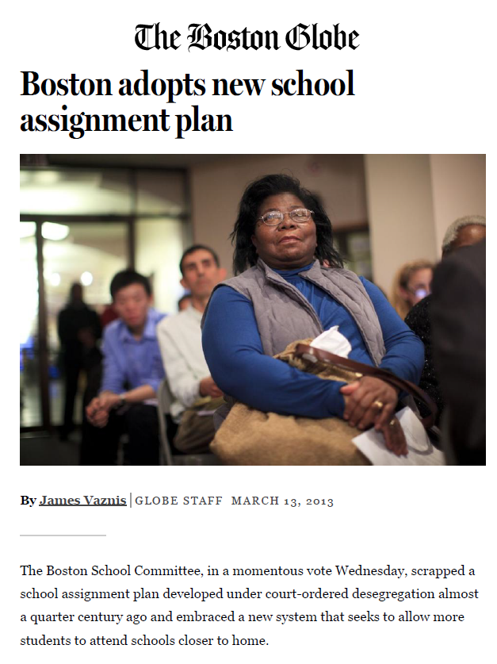
Boston Adopts the Home-Based Plan
Implemented across Boston Jan 2014.

Slide 21
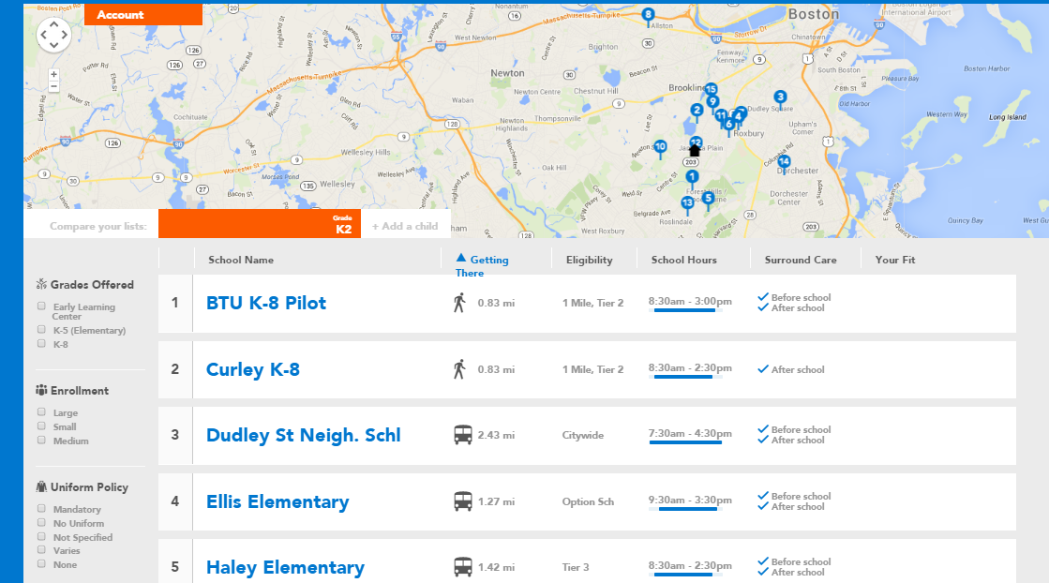
Screenshot of Implementation

Slide 22
Outline
Problem
Background
Policy question
Simulation
Choice modeling
Defining metrics
Simulating outcomes
Optimization
Simplification
LP formulation
Column generation
Python implementation

Slide 23
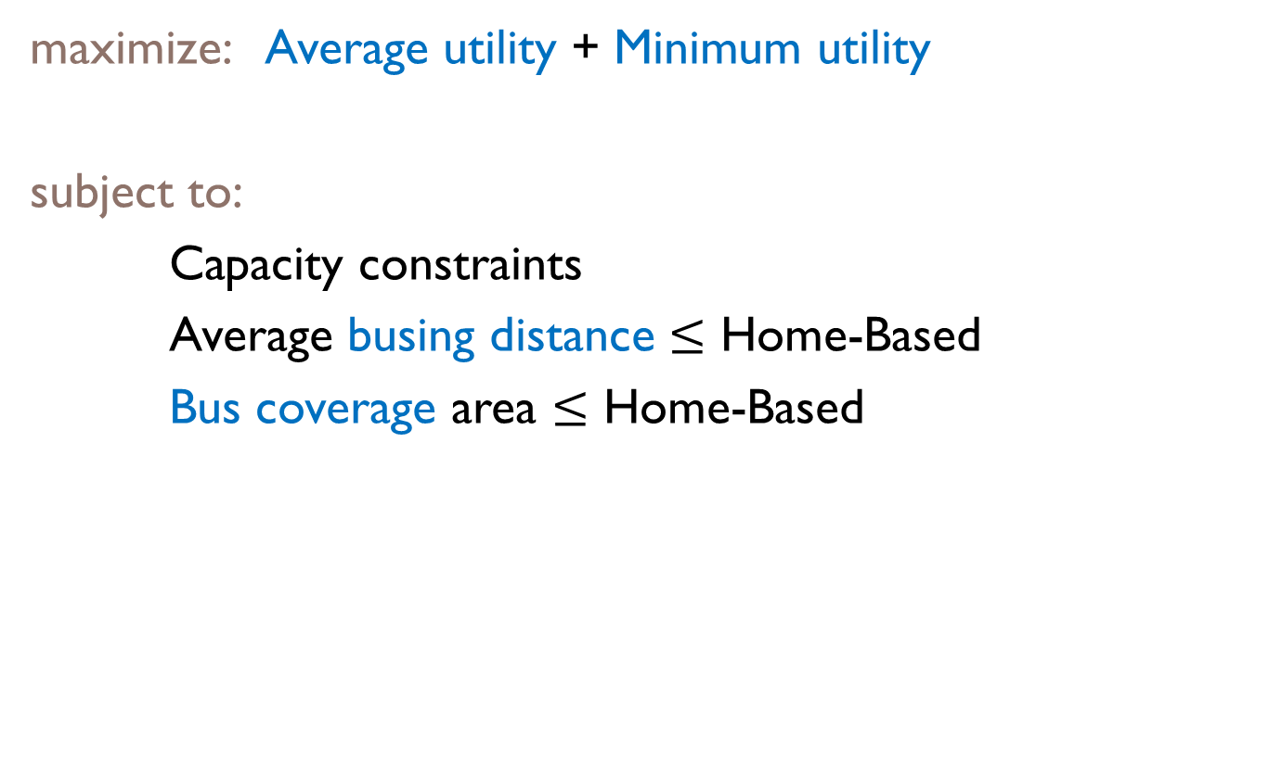
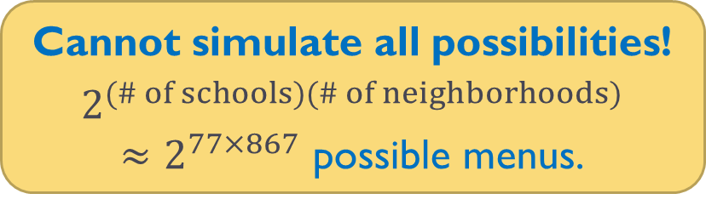
Ideal Formulation (Intractable)
maximize: Average utility + Minimum utility
subject to:
Capacity constraints
Average busing distance $≤$ Home-Based
Bus coverage area $≤$ Home-Based
menus, priorities
Difficulty: Priorities couple my assignment with others’ choices!
Cannot simulate all possibilities!
$2^{(\# of schools)(\# of neighborhoods)}≈2^{77×867}$ possible menus.

Slide 24
Simplification
Original Model
Decision Variables
Simplified Model
Home Location
Home Location
Random Assortment
Menus
Priorities
Choice Ranking
Top Choice
DA Algorithm
Distribution of Outcomes
Distribution of Outcomes
Large market theory: enough to solve the simplified model!

Slide 25
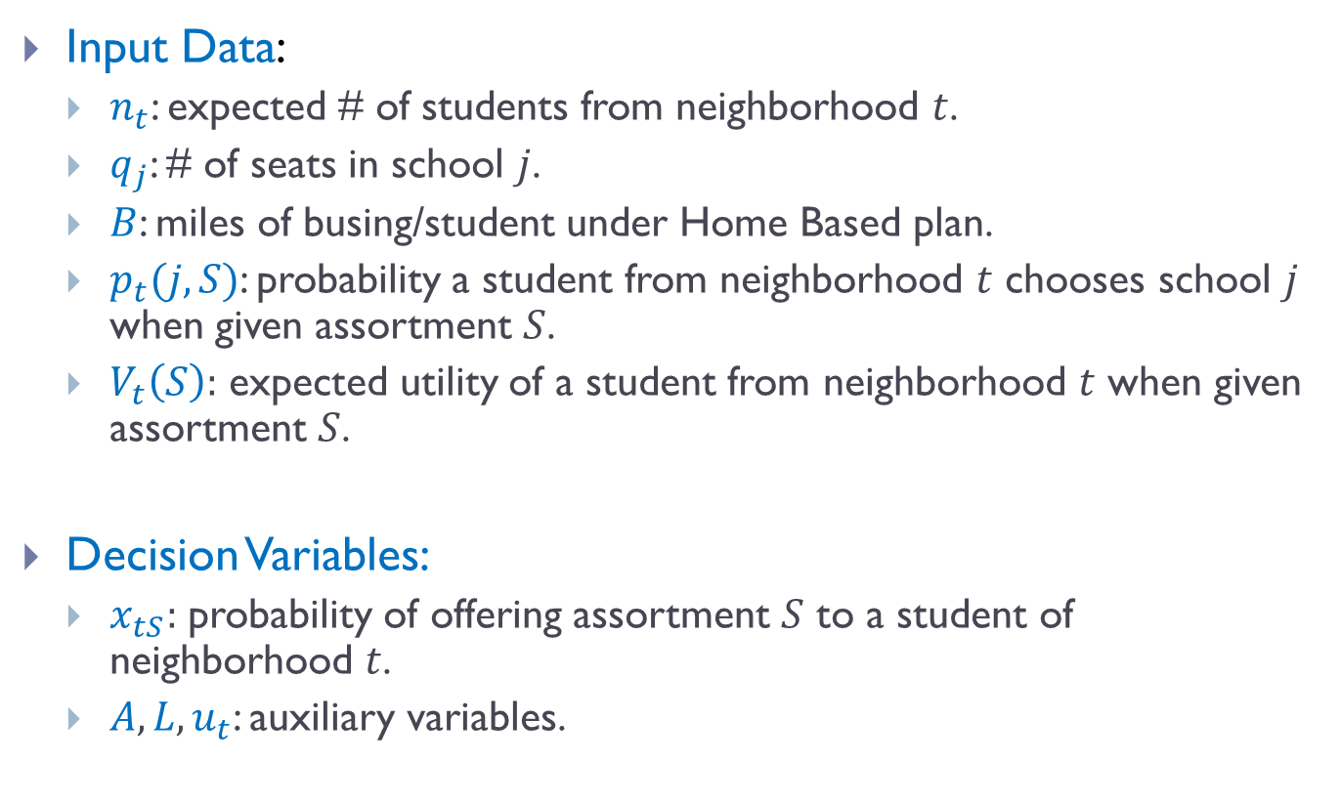
LP Formulation
Input Data:
$n_{t}$: expected # of students from neighborhood $t$.
$q_{j}$: # of seats in school $j$.
$B$: miles of busing/student under Home Based plan.
$p_{t}(j,S)$: probability a student from neighborhood $t$ chooses school $j$ when given assortment $S$.
$V_{t}\left(S\right):$ expected utility of a student from neighborhood $t$ when given assortment $S$.
Decision Variables:
$x_{tS}:$ probability of offering assortment $S$ to a student of neighborhood $t$.
$A,L,u_{t}$: auxiliary variables.

Slide 26
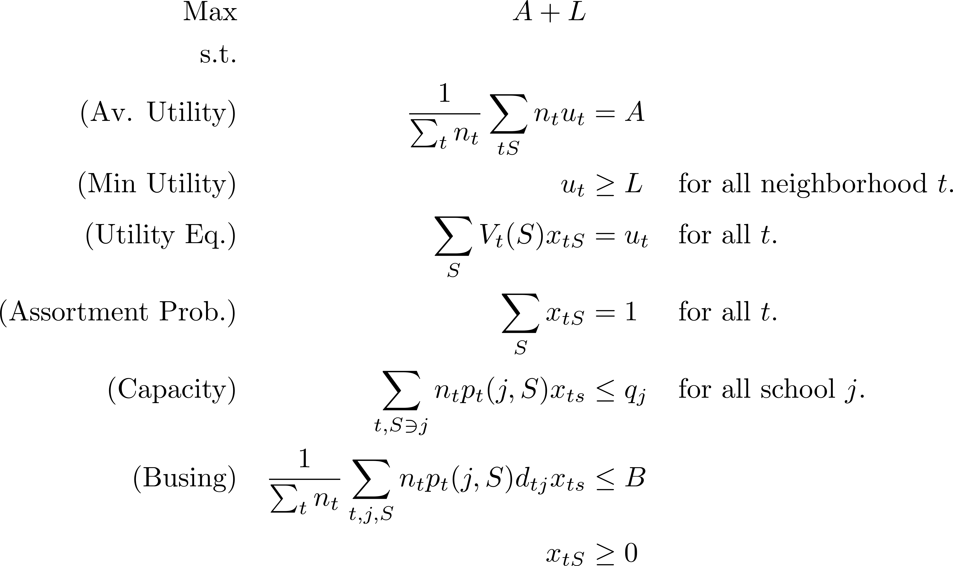
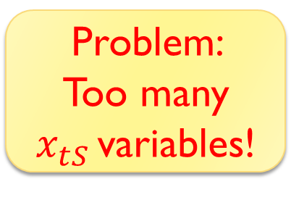
LP Formulation
Problem:
Too many $x_{tS }$variables!

Slide 27
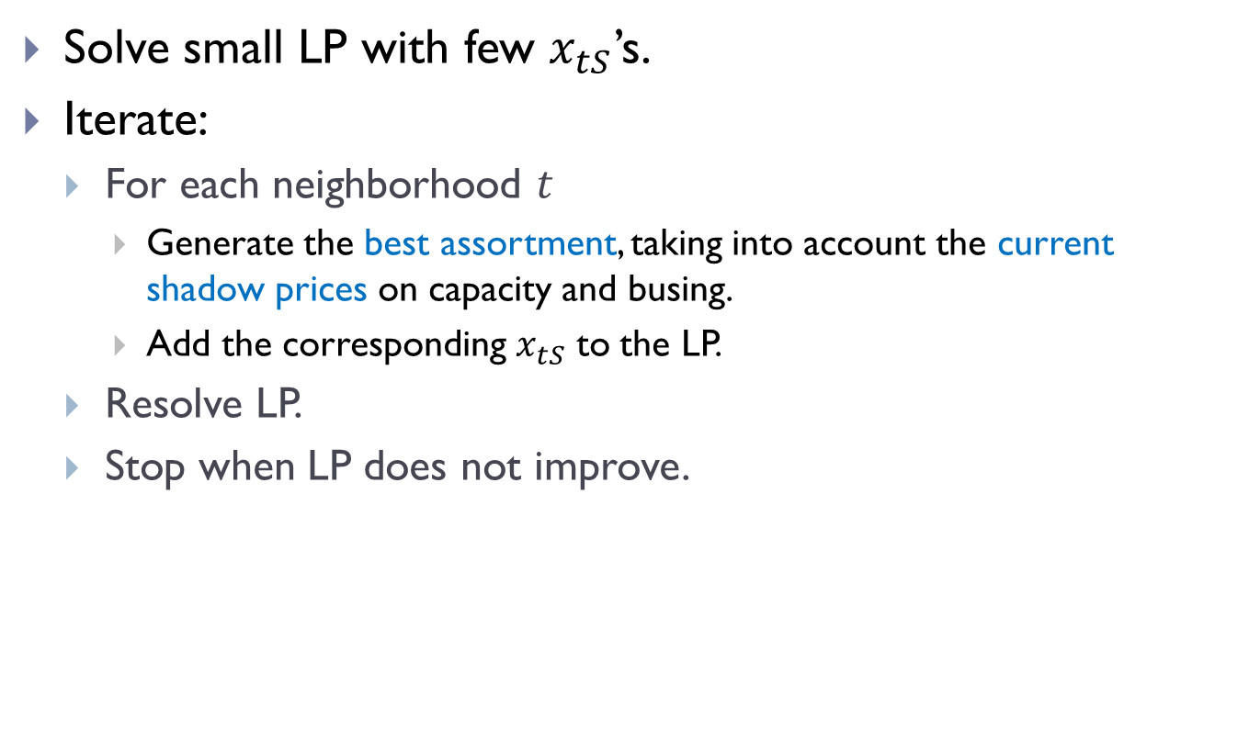





Solution: Add $x_{tS}$ Variables only as Needed
Solve small LP with few $x_{tS}$’s.
Iterate:
For each neighborhood $t$
Generate the best assortment, taking into account the current shadow prices on capacity and busing.
Add the corresponding $x_{tS}$ to the LP.
Resolve LP.
Stop when LP does not improve.
$$2$$
B
Name of technique: “column generation”
$$4$$
$$4$$
A
C
$$t$$

Slide 28
Python Implementation
Input data:
Student demographics and school characteristics.
Choice model parameters.
Output from Gurobi:
Optimal assortment probabilities.
Final output:
Menu for each neighborhood
Priority boosts:
$${priority}_{is}={boost}_{ts}+{lottery}_{is}$$

Slide 29
Simulation Result
Metric | 3-Zone | Home-Based
Average # of choices: | 27.5 | 14.8
Average busing (miles) | 1.3 | 0.6
Bus coverage (sq. miles) | 20.9 | 8.5
Expected utility (miles)
Average | 7.4 | 7.0
10th percentile | 6.6 | 6.1
Minimum | 5.1 | 4.5
Prob. of getting top choice in menu
Top 1 | 63% | 64%
Top 3 | 84% | 84%
# of peers living within half mile (median) | 3.1 | 5.0
Optimized
15.0
0.6
8.3
7.5
6.7
6.5
85%
96%
5.0
Benefits:
Busing
Savings
Efficiency
Equity
Predict-
ability
Community
Cohesion
Optimized plan achieves best of both worlds!

Slide 30
Takeaways
Simulations help bypass rhetorical gridlock.
LP/MIP modeling is powerful.
Optimization + simulation: powerful and persuasive prescriptive analytics.

Slide 31
Intersection with DSO-570
Simulation
Choice modeling
Defining metrics
Simulating outcomes
Optimization
Simplification
LP formulation
Column generation
Python implementation

